Slide 1
Synchrony of Water Levels across the state of WI

Slide 2
Data
138 Wells and Lakes
Choose a single representative well from the LTER data due to issues with 30 wells in close proximity with nearly identical trends exerting a strong influence on our analyses.
12-15 Years of data (2001:2015)
Annual summer median value

Slide 3
Geography of synchrony
Dynamic Time Warping
Kernel K-means Clustering
Notes:
Finding patterns in a noisy environment is a significant challenge with this type of data.
We have collaborated with computer scientist and his solution was to draw on speech recognition algorithms, specifically dynamic time warping.
So instead of people saying "hey siri, what does limnology mean" and siri figuring it out, we feed the algorithm water clarity data and let it tell us how similar the patterns are.
We then use kernel k-means clustering to identify lakes with similar LT patterns, and finally fit a bayes common trend model to the data to indentify the different patterns.

Slide 4
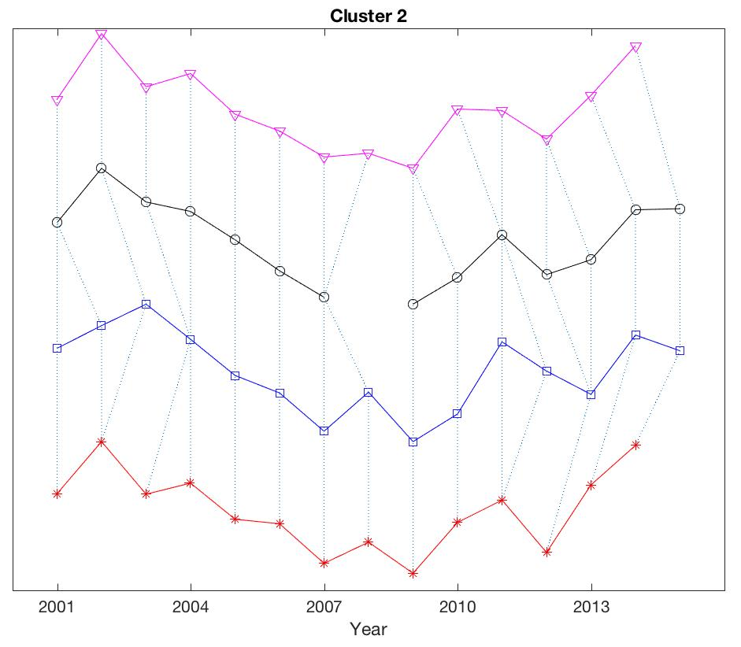
Dynamic Time Warping Specifics
Algorithm developed for speech recognition
Handles missing data
Align time series that are slightly asynchronous
Estimates a difference/similarity metric between time series that can be used to identify suites of time series with similar long-term patterns
Used a DTW window of +/- 1 yrs
Notes:
DTW plot shows 4 time series from cluster 2 which all have a U-shaped pattern (high in 2001, low in 2008, and recovery by 2015) which is characteristic of the patterns in northern WI. The dashed lines show how the DTW algorithm is aligning individual and potentially asynchronous points between each time series. D

Slide 5
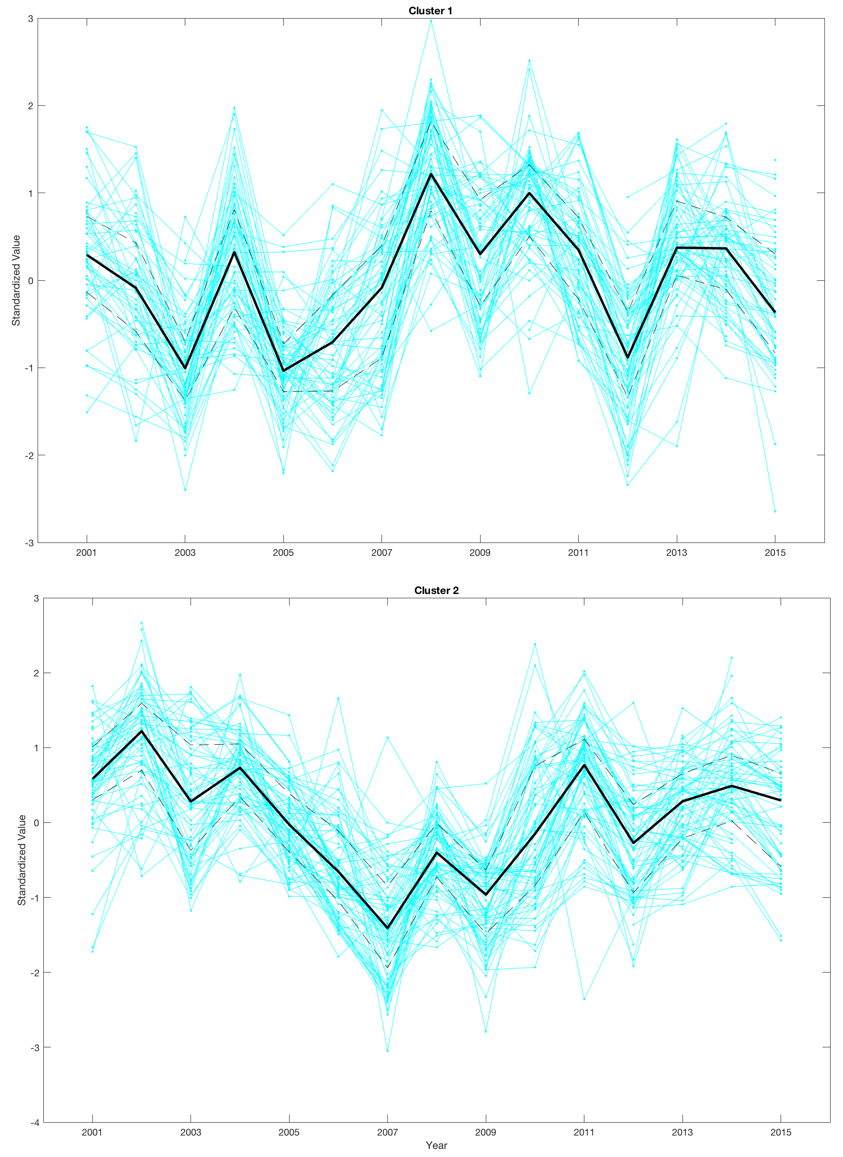
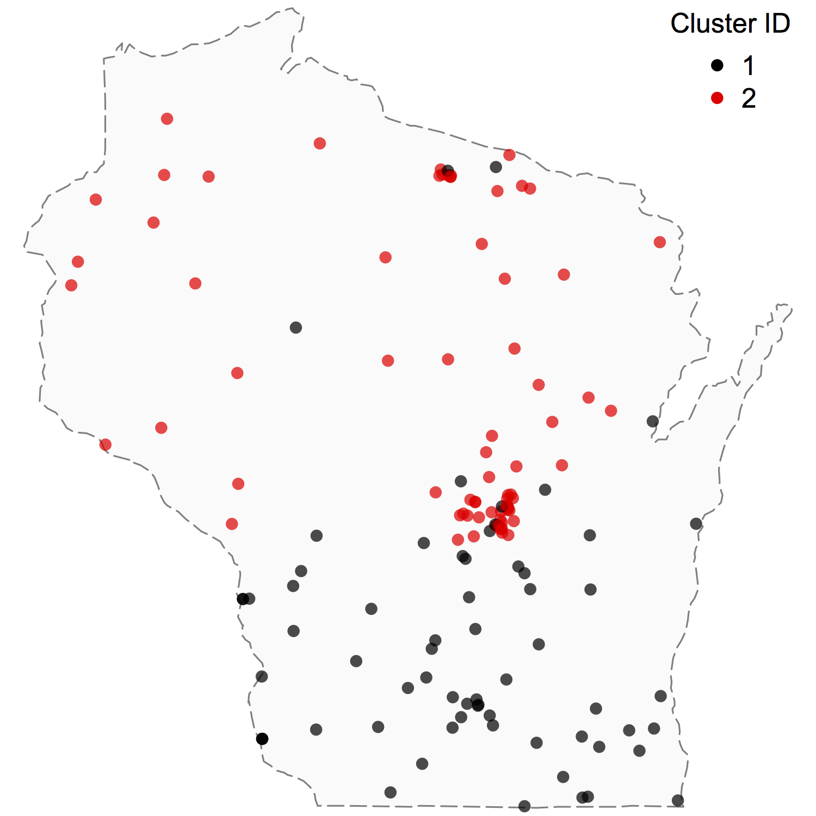
Water Level Patterns

Slide 6
What landscape/climate factors can help us predict long-term water level patterns
Predictor Variables
Record Type
Lake vs. Well
Landscape
Landcover/landuse @ HU4, HU8, HU12 spatial scale
Geology
Sediment type (e.g., glacial outwash, till) @ HU4, HU8, HU12 spatial scale
Climate
Precipitation, baseflow, groundwater recharge @ HU4, HU8, HU12 spatial scale

Slide 7
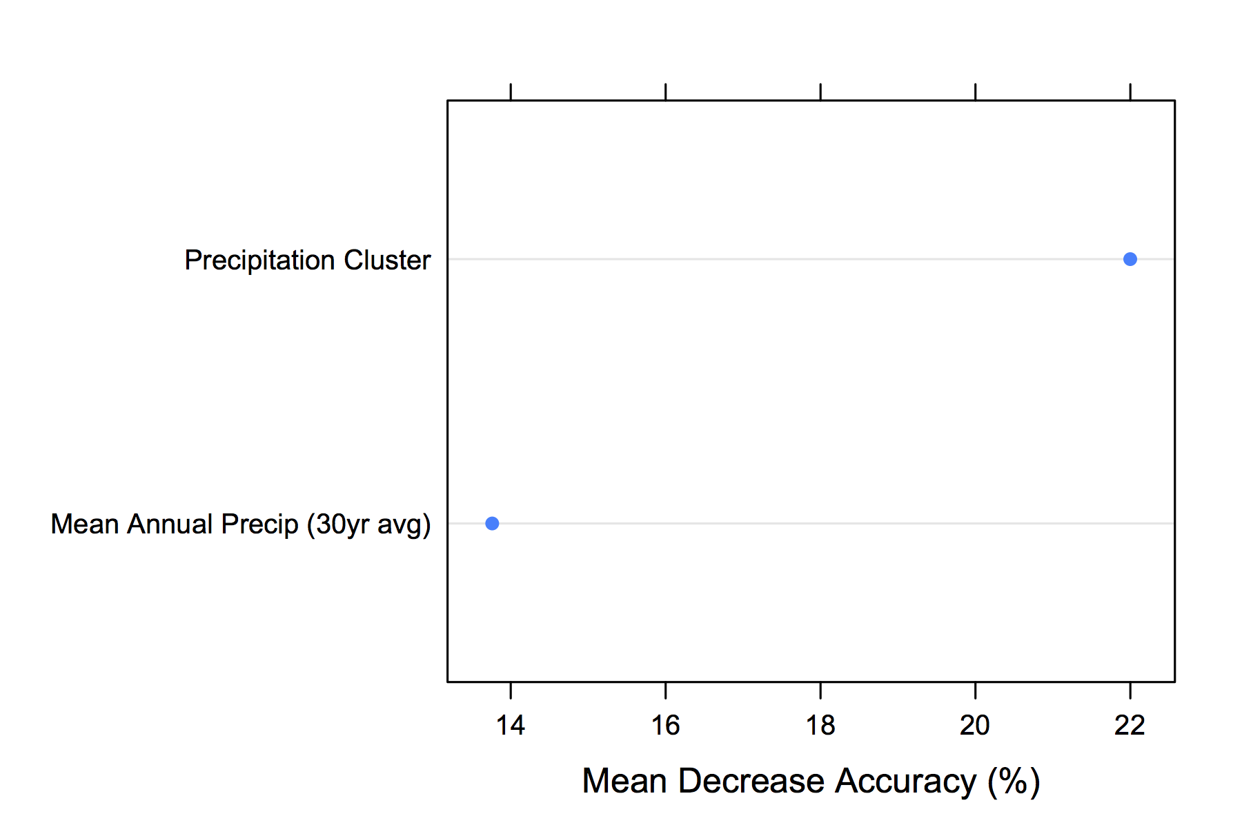
Results from Random Forest Classification Models
Correctly classify 89% (83% – 94%) of sites
Variable selection suggests 3 important variables for predicting water level pattern clusters

Slide 8
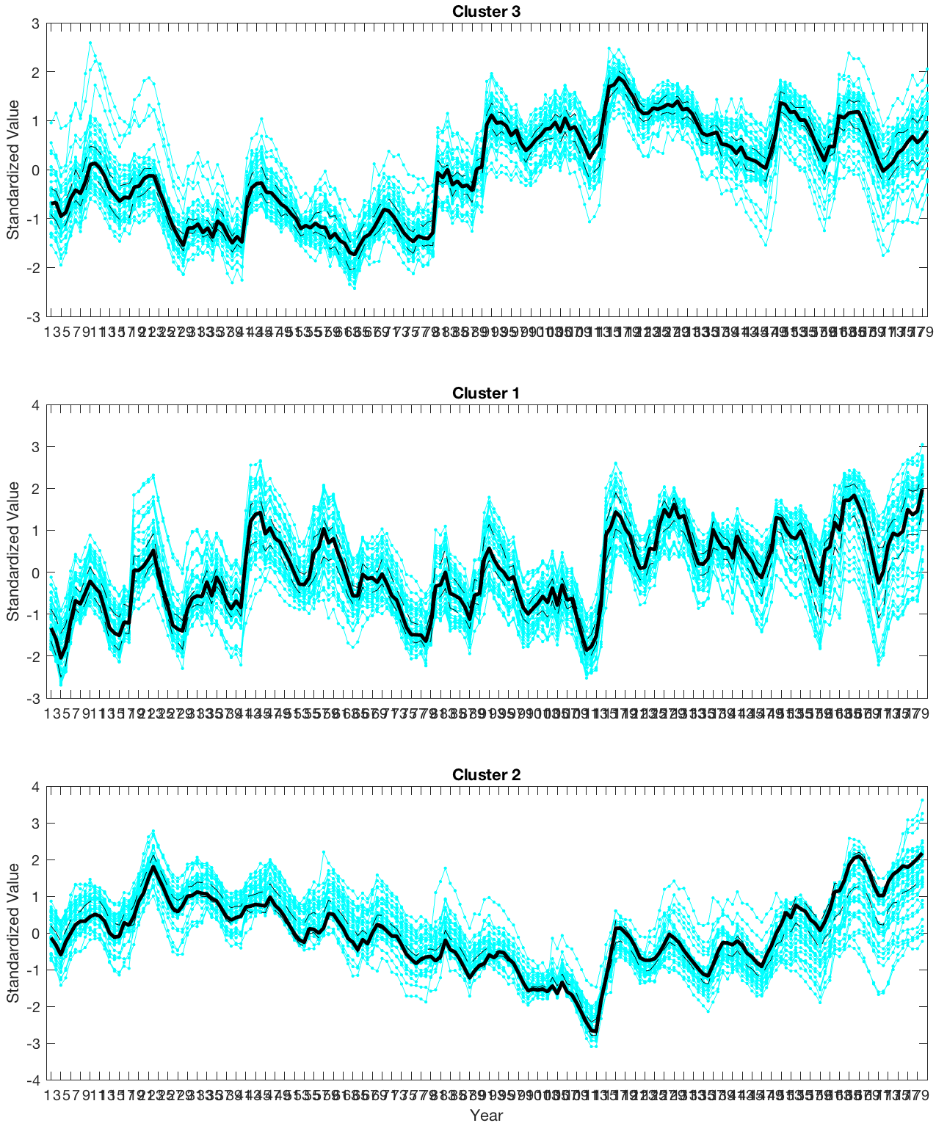
Long-term Precipitation Pattern
Water Levels
Precipitation Cumulative Deviation

Slide 9
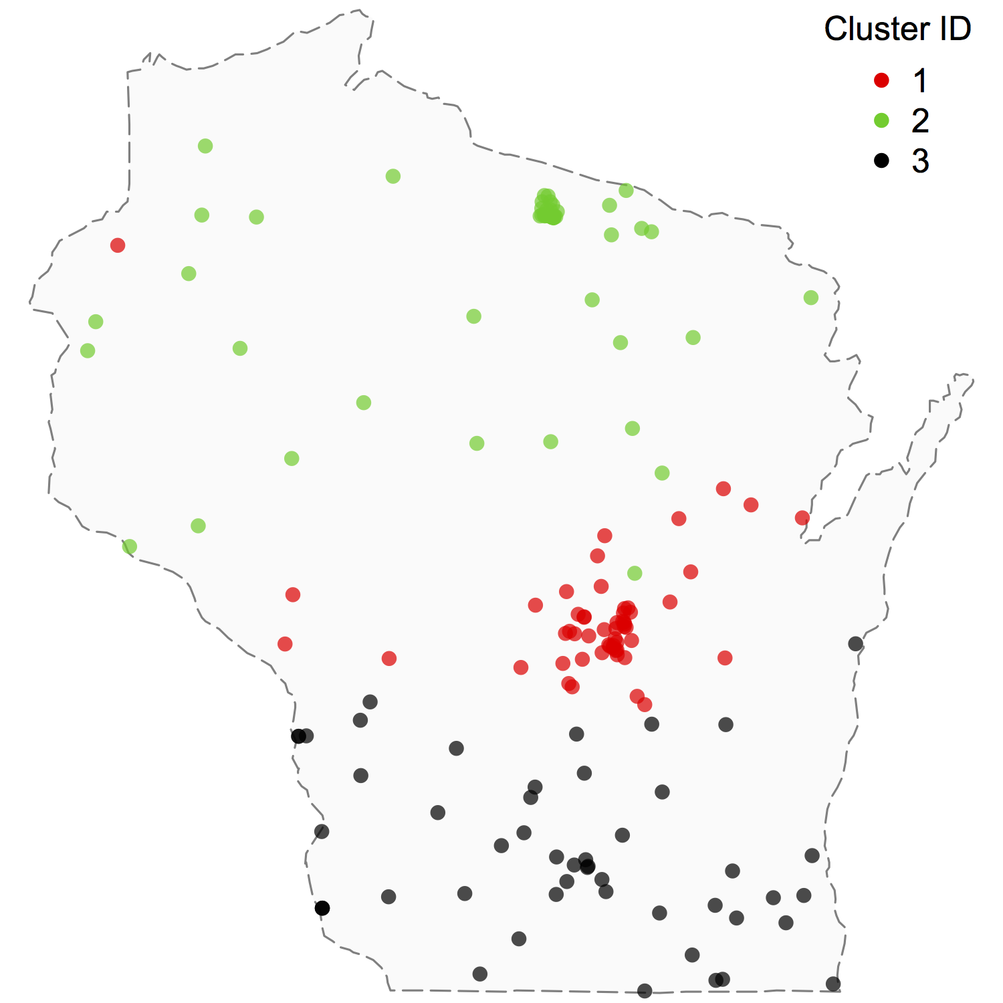
Long-term Precipitation Pattern
Water Levels
Precipitation Cumulative Deviation

Slide 10
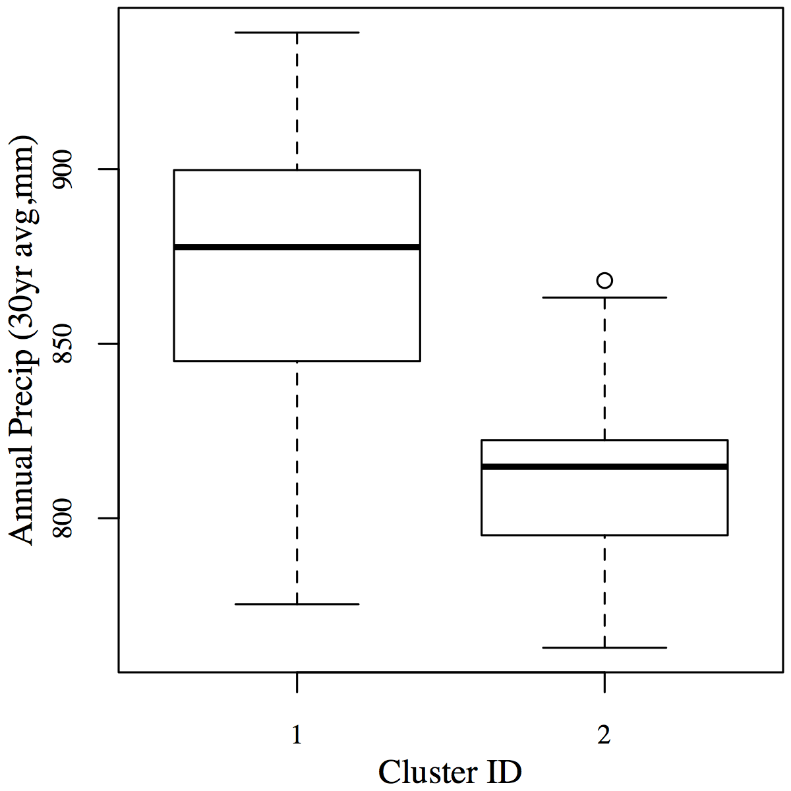
Average Annual Precipitation

Slide 11
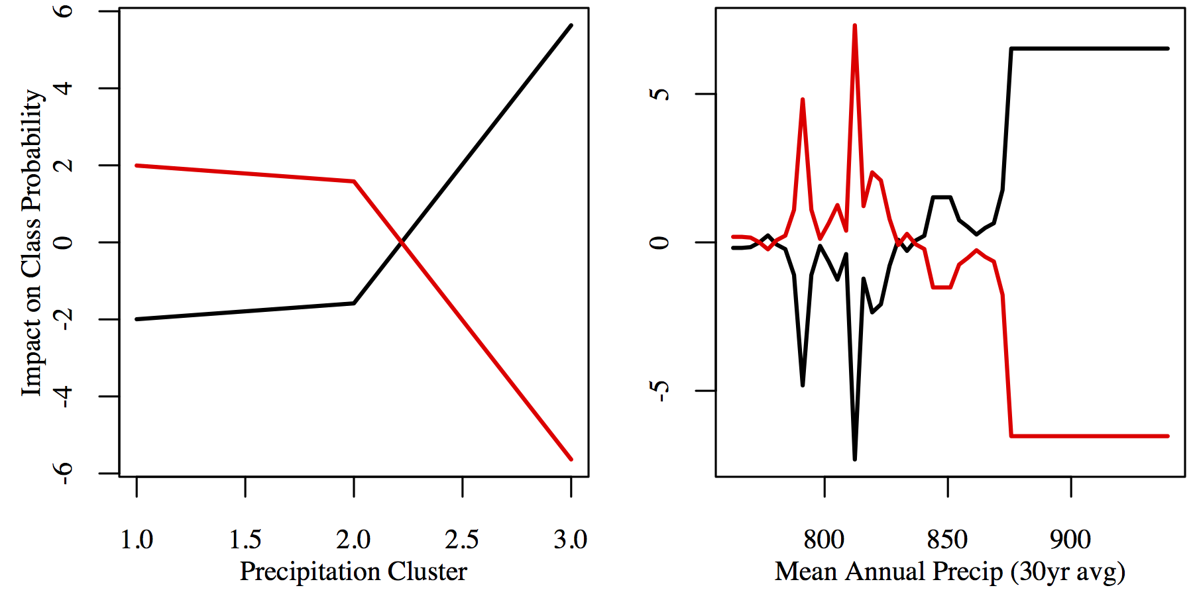
Partial Dependency Plots

Slide 12
Take Home Message
North/South gradient in water level patterns
Dividing line is around the central sands area
Lakes and groundwater levels do not have significantly different patterns across the state
Precipitation (amount and long-term pattern) appears to play an important role in long-term water level patterns

